Slide 1
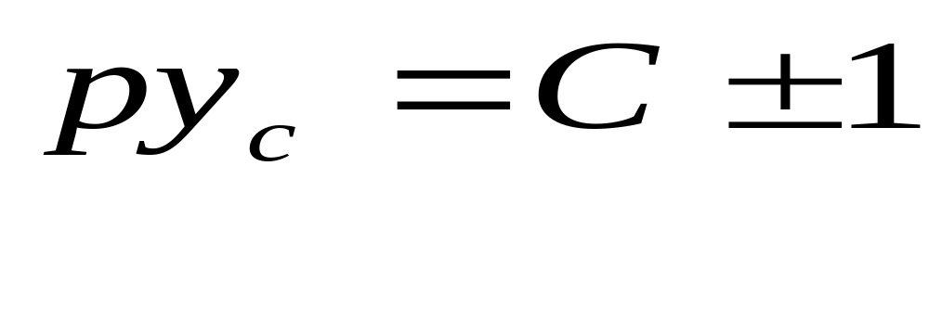
Simple wave winding
A practicable wave winding must satisfy the relation
It is”+1 ” for progressive winding and “ -1”for retrogressive winding.

Slide 2
The relation ensures two things:
that after one tour of the armature periphery, the end of the last coil falls on the commutator segment next to the beginning of the first coil and
that after several (= y_{c} )similar tours of the armature all the commutator segments are occupied and the final coil falls naturally on the first giving a closed winding.

Slide 3
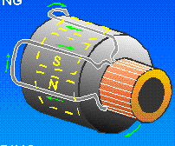

Slide 4
No. of poles commonly used for dc machines is 4, 6 or 8
  For 4- and 8-pole machines, C must be odd and since C = u x S, u and S must also be odd. u is usually 1, 3 or 5.
  For a 4-pole machine u is usually 3.

Slide 5
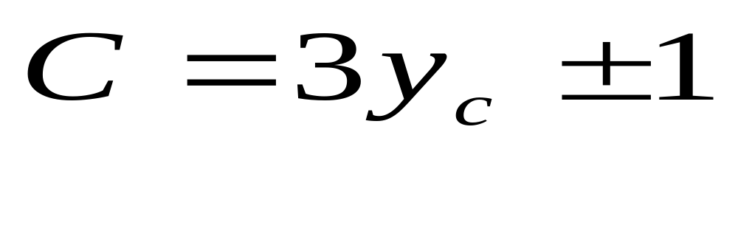
  For 6-pole machine, u is any number not a multiple of 3. u used is 2 or 4. Check from this equation:

Slide 6
In this winding, the arrangement is such that all coils carrying current in the same direction at any instant are connected in series.

Slide 7
Since coil has either its current in the clockwise or anticlockwise direction, the number of parallel paths is 2.
    In general, the number of coils joined in series between adjacent commutator segments = p

Slide 8
No. of brushes required can be 2 spaced at 1/2p of the commutator circumference.
Check as follows:
No. of commutator segments =No. of coils = C

Slide 9
No. of commutator segments embraced by brushes = C/2p
No. of coils joined in series between the brushes = C/2p x p =C/2

Slide 10
In their normal position, the brushes make contact with conductors which are moving through the low-flux interpolar zone.
Their positions can be found by
  drawing an equivalent ring diagram (this can be drawn with the aid of winding table),

Slide 11
  finding the commutator bar where two emfs separate (the position of negative brush for generator action) and
  also finding the commutator bar where two emfs join (the position of positive brush).

Slide 12
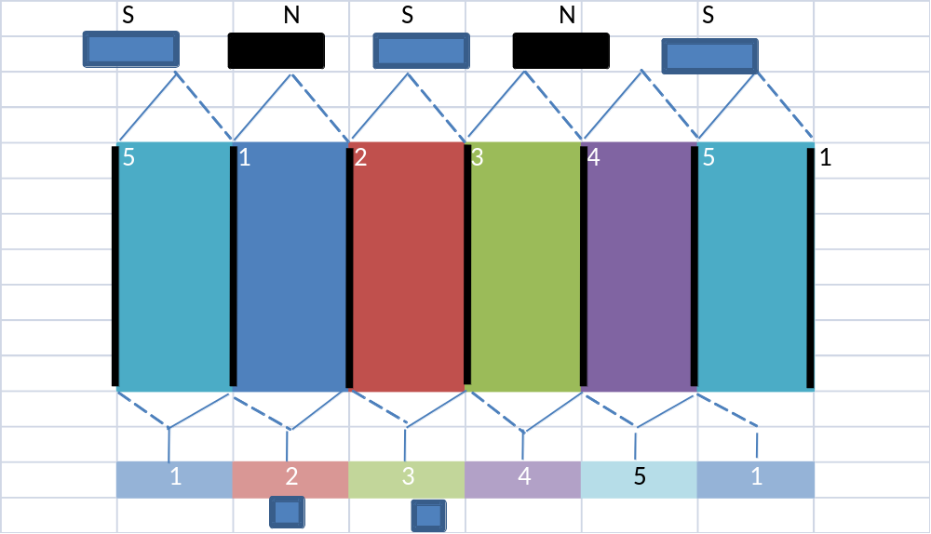


Slide 13
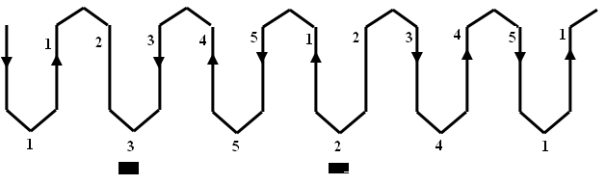

Slide 14
The number of brushes used in practice = 2p .
This is to lower the current per brush and thus keep down the length of the brushes so that short and therefore cheap commutator can be used.
They are spaced symmetrically as in lap winding.

Slide 15
When extra brushes are used, a few coils in the low-flux interpolar zone are shorted out but this has little effect on the output voltage of a practical machine.
The progression of wave winding is conveniently indicated in a table called winding table.

Slide 16
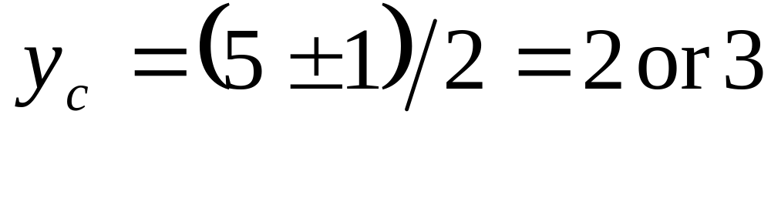
Consider a simple wave winding with the following parameters: S= 5, p= 2, u= 1
  For this winding, take y_{c} = 2
  This gives retrogressive winding.

Slide 17
  Slot span = S/2p = 5/4 = 1.25 = 1 (the nearest lower integer)
  Coil span y_{b} = slot span x number of coils/slot (or coil sides per layer)
= slot span x u = 1 x 1 = 1

Slide 18
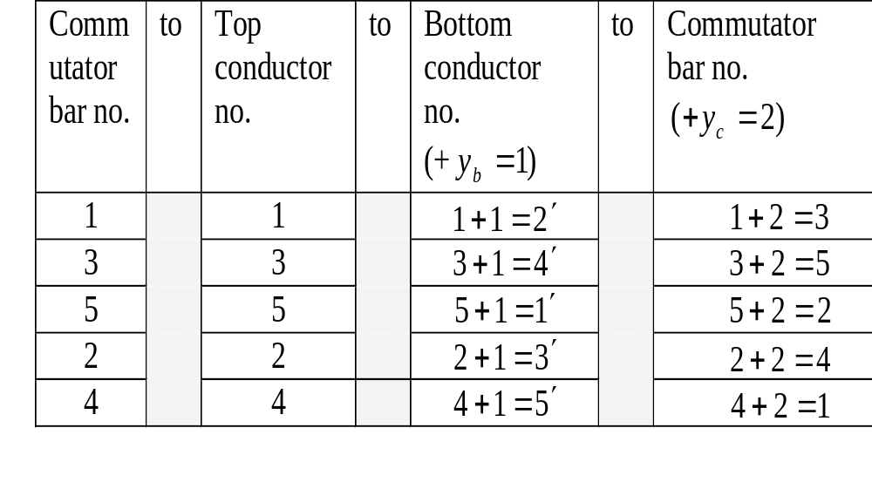
We make the following observations:

Slide 19
Starting from comm. bar 1, after one tour of the armature periphery, the end of the last coil falls on comm. bar 5 which is next to comm. bar 1.
It falls on the adjacent commutator bar 5 but NOT adjacent commutator bar 1 because the winding is retrogressive.

Slide 20
After the y_{c} = 2 tours, all the commutator bars are occupied.
The final coil of the last tour (the second tour) falls on the commutator bar 1 we started with to give a closed winding.

Slide 21
Exercise 4: The total number of conductors for a simple wave armature winding is required to be approximately 760, a tolerance of 5 % more, or less, being allowed. The no. of slots is to be bet^{n} 39 and 45, and of comm. bars bet^{n} 117 and 135. There are 4 poles.

Slide 22
C, S and u for the winding must all be odd. Why?
[Use py_{c} = C + or – 1 or 2y_{c} = C + or – 1]
Determine all possible number of slots.
[41, 43 since S is odd]

Slide 23
Choose the lowest possible number of slots and use it to determine
  the maximum number of coils per slot [C_{max} = 133, S = 41, u_{max} = 3.2 = 3]
  the minimum number of coils per slot [C_{min} = 119, S = 41, u_{min} = 2.9 = 3]

Slide 24
  the maximum number of conductors per slot [Z_{max} = 760 + 5% = 798, Ans = 19.4 = 18 because Z/slot should be even]
  the minimum number of conductors per slot.
  [Z_{min} = 760 - 5% = 722, Ans = 17.6 = 18]

Slide 25
For the number of slots chosen in part (c), determine the following other particulars for a suitable winding:
  the number of coils per slot [u_{max} = 3, u_{min} =3 therefore u =3]

Slide 26
  the number of conductors per slot [Min = 18, Max =18 therefore it should be 18. Note that it is also supposed to be multiple of 3 and this happens to be the case]
  the number of comm. segments [C = S x u = 41 x 3 = 123]

Slide 27
the commutator pitch if winding is progressive.
[2y_{c} = C + 1 = 123 + 1 = 124, y_{c} = 62]

Slide 28
Determine the no. for bottom conductors for coil 1 if its top conductors are given the number 1 .
[slot span = S/2p = 41/4 = 10.25 = 10;
y_{b} = slot span x u = 10x 3 = 30.
Hence no. is 1+30= 31']

Slide 29
Show by diagram how the conductors are arranged in a slot and use it to determine the number of turns in a coil. [Arrangement is 6 rows, 3 columns giving the no. of turns as 3]

